Slide 1
JAVA concepts

Slide 2
Packages in java
Package in Java is a mechanism to encapsulate a group of classes, sub packages and interfaces.
Uses :
Preventing naming conflicts
Making searching/locating and usage of classes, interfaces, enumerations and annotations easier
Providing controlled access
Packages can be considered as data encapsulation (or data-hiding)
How Packages works
Works same as Directory structure
Example: college.staff.cse
Notes:
Packages are used for:
Preventing naming conflicts. For example there can be two classes with name Employee in two packages, college.staff.cse.Employee and college.staff.ee.Employee
Making searching/locating and usage of classes, interfaces, enumerations and annotations easier
Providing controlled access: protected and default have package level access control. A protected member is accessible by classes in the same package and its subclasses. A default member (without any access specifier) is accessible by classes in the same package only.
Packages can be considered as data encapsulation (or data-hiding).
Package names and directory structure are closely related. For example if a package name is college.staff.cse, then there are three directories, college, staff and cse such that cse is present in staff and staff is present college. Also, the directory college is accessible through CLASSPATH variable, i.e., path of parent directory of college is present in CLASSPATH. The idea is to make sure that classes are easy to locate.

Slide 3
Packages in java
Package naming conventions
Adding a class to a Package
Sub-packages
Notes:
Package naming conventions : Packages are named in reverse order of domain names, i.e., org.geeksforgeeks.practice. For example, in a college, the recommended convention is college.tech.cse, college.tech.ee, college.art.history, etc.
Adding a class to a Package : We can add more classes to a created package by using package name at the top of the program and saving it in the package directory. We need a new java file to define a public class, otherwise we can add the new class to an existing .java file and recompile it.
Subpackages: Packages that are inside another package are the subpackages. These are not imported by default, they have to imported explicitly. Also, members of a subpackage have no access privileges, i.e., they are considered as different package for protected and default access specifiers.

Slide 4
Accessing classes inside a package
// import the Vector class from util
package. import java.util.vector;
// import all the classes from util package
import java.util.*;
------------------------------------------------------------------------------------------------------------------------------------------
// All the classes and interfaces of this package
// will be accessible but not subpackages.
import package.*;
// Only mentioned class of this package will be accessible.
import package.classname;
------------------------------------------------------------------------------------------------------------------------------------------
// Class name is generally used when two packages have the same
// class name. For example in below code both packages have
// date class so using a fully qualified name to avoid conflict
import java.util.Date;
import my.packag.Date;
Notes:
First Statement is used to import Vector class from util package which is contained inside java.
Second statement imports all the classes from util package.

Slide 5


Example
// Java program to demonstrate accessing of members when // corresponding classes are imported and not imported. import java.util.Vector; public class ImportDemo { public ImportDemo() { // java.util.Vector is imported, hence we are // able to access directly in our code. Vector newVector = new Vector(); // java.util.ArrayList is not imported, hence // we were referring to it using the complete // package. java.util.ArrayList newList = new java.util.ArrayList(); } public static void main(String arg[]) { new ImportDemo(); } }

Slide 6
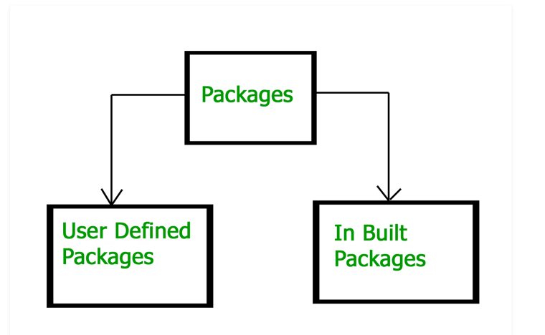
Types of packages
Built-in packages : These packages consists of large number of classes which are JAVA API.
User-defined packages : defined by the user.
Notes:
These packages consist of a large number of classes which are a part of Java API.Some of the commonly used built-in packages are: 1) java.lang: Contains language support classes(e.g classed which defines primitive data types, math operations). This package is automatically imported. 2) java.io: Contains classed for supporting input / output operations. 3) java.util: Contains utility classes which implement data structures like Linked List, Dictionary and support ; for Date / Time operations. 4) java.applet: Contains classes for creating Applets. 5) java.awt: Contain classes for implementing the components for graphical user interfaces (like button , ;menus etc). 6) java.net: Contain classes for supporting networking operations.

Slide 7
Static imports
Static import is a feature introduced in Java programming language ( versions 5 and above ) that allows members ( fields and methods ) defined in a class as public static to be used in Java code without specifying the class in which the field is defined.
// Note static keyword after import.
import static java.lang.System.*;
class StaticImportDemo
{
public static void main(String args[])
{
// We don't need to use 'System.out'
// as imported using static.
out.println("GeeksforGeeks");
}
}

Slide 8
Handling name conflict
Example:
Problem:
import java.util.*;
import java.sql.*;
//Compiler will be in conflict which Date to use.
Solution:
import java.util.Date;
import java.sql.*;
//in case of user need both the objects
java.util.Date deadLine = new java.util.Date();
java.sql.Date today = new java.sql.Date();

Slide 9
Points to remember
Every class is part of some package.
If no package is specified, the classes in the file goes into a special unnamed package (the same unnamed package for all files).
All classes/interfaces in a file are part of the same package. Multiple files can specify the same package name.
If package name is specified, the file must be in a subdirectory called name (i.e., the directory name must match the package name).
We can access public classes in another (named) package using: package-name.class-name

